Slide 1
Financial Consumer Complaint Classification
IST 718 Big Data Analytics - Spring 2024
Group 4
Francisco Franco Arenas
Qidu Quentin Fu
Yixing (Leo) Zhu
Ximeng Deng

Slide 2
Table of Contents
Overview: Problem & Objective
Dataset Description
Data Cleaning
Feature Engineering
2-Stages Prediction Models
Conclusion and Reflection

Slide 3


Overview: problems and objectives
Problems:
Financial consumer complaint texts are
1) of large volume,
2) unstructured,
3) inefficient for manual processing.
Objectives: to better understand consumer financial issues and improve complaint handling
Understand consumer financial issues
Improve complaint handling
Analyze the complaint data to identify key pain points and issues consumers face with financial services
Leverage insights from complaint analysis to improve complaint resolution processes

Slide 4
Table of Contents
Overview: Problem & Objective
Dataset Description
Data Cleaning
Feature Engineering
2-Stages Prediction Models
Conclusion and Reflection

Slide 5
Data description: The data is 4m + rows and 18 columns spanning collected from 2015 to 2023
Data source
Live database: https://catalog.data.gov/dataset/consumer-complaint-database
Time span
2015 - 2023
Features
18 columns and 4,506,189 rows.
Variables
Target variable: Product
Predictors: Date Sent to the Company, Sub-Issue, Company, Narrative, and Zip Code

Slide 6
Table of Contents
Overview: Problem & Objective
Dataset Description
Data Cleaning
Feature Engineering
2-Stages Prediction Models
Conclusion and Reflection

Slide 7
Data cleaning: Thematically group issues together based their issues
Method
Thematic analysis groups the issues into fewer ones.
Category numbers
13 ➔ 5

Slide 8
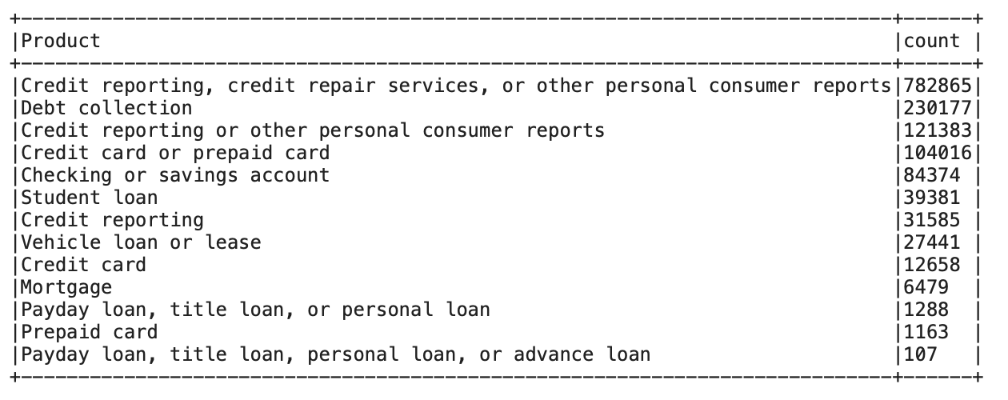
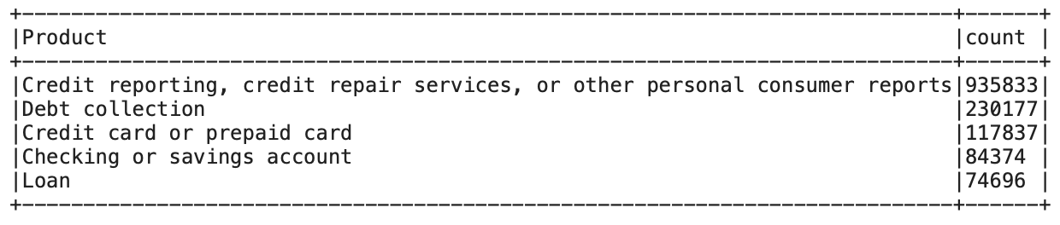
Data cleaning: Thematically group issues together based their issues
Before
After

Slide 9


Data cleaning
Cleaning drops NULLs and duplicates, renames categories of the target variable product, and selects relevant
Drop nulls & duplicates
Rename products
Select features
Text preprocessing pipeline 1) lowercase, 2) remove placeholders, punctuations, stop words, emojis/emoticons & special characters, 3) tokenize, normalize, and lemmatize tokens.
Removal
Further preprocessing
Lowercase

Slide 10
Table of Contents
Overview: Problem & Objective
Dataset Description
Data Cleaning
Feature Engineering
2-Stages Prediction Models
Conclusion and Reflection

Slide 11
Feature Engineering
Vectorization of Consumer complaint narrative, IDF
Doesn’t work - utilizes Spark NLP to build and apply a BERT embedding (small_bert_L2_128 model) pipeline to the textual data, generating dense vector representations for each token.
Alternative - IDF, vocabSize = 500, minDF = 2.0
Encode month and day with cyclical transformation
One hot encode company
Ensemble all transformation and creation of features for ML
indexing the Product column for two stages ML
Splitting to train and test dataframe (0.8-0.2)

Slide 12
Feature Engineering
Vectorization of Consumer complaint narrative, IDF
Encode month and day with cyclical transformation
Normalizing month and date to [0-1] range and then multiplying by 2*pi to get the angle within a full circle.
The features used are the sin and cos of those angles, so day 31st and 1st and month 12 and 1 are consecutive.
One hot encode company
Ensemble all transformation and creation of features for ML
indexing the Product column for two stages ML
Splitting to train and test dataframe (0.8-0.2)

Slide 13
Feature Engineering
Vectorization of Consumer complaint narrative, IDF
Encode month and day with cyclical transformation
One hot encode company
Problem: more than 1,000 companies, therefore this approach exploded dimensionality.
Ensemble all transformation and creation of features for ML
indexing the Product column for two stages ML
Splitting to train and test dataframe (0.8-0.2)

Slide 14
Feature Engineering
Vectorization of Consumer complaint narrative, IDF
Encode month and day with cyclical transformation
One hot encode company
Ensemble all transformation and creation of features for ML
indexing the Product column for two stages ML
First stage: label 0 for majority class, label 1 otherwise
Second stage: labels 2-5 for the remaining classes
Splitting to train and test dataframe (0.8-0.2)

Slide 15
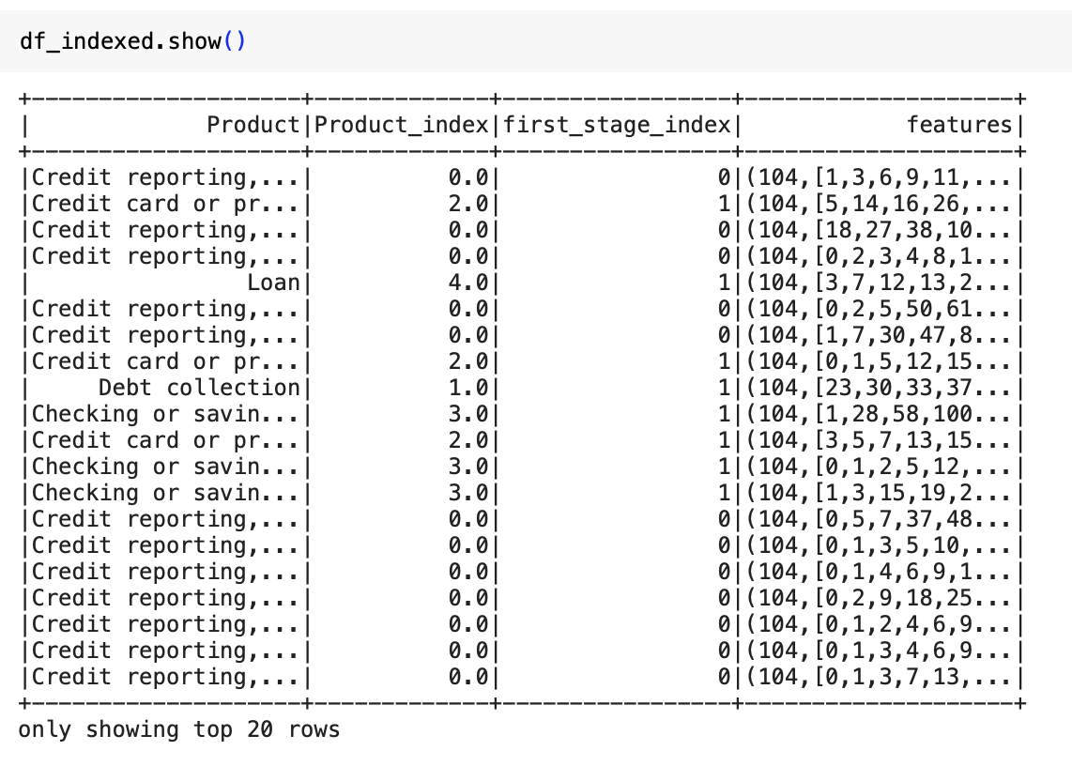
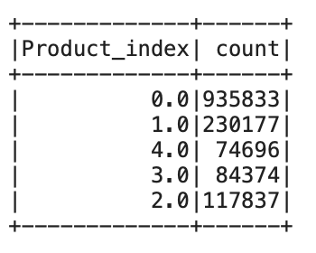
Product index & First stage index
0 for first category, 1 otherwise, in float type because it needs it for the confusion matrix

Slide 16
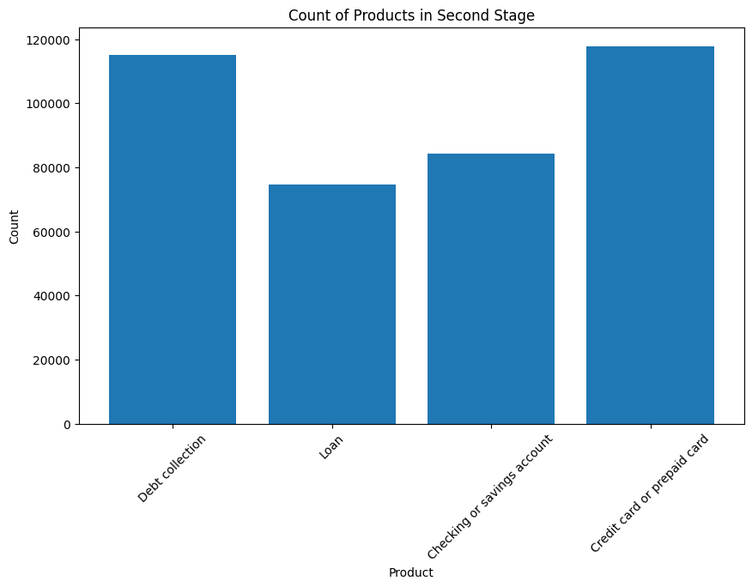
Downsampling for the Second stage
Filter out rows where Product_index is 0.0 (Credit reporting)
Randomly sample 50% of the rows where Product_index is 1.0 (Debt collection)
Keep all other rows

Slide 17
Prediction Models
First stage: Predict the majority class
Second stage: Predict the minority classes
Merge both predictions and obtain confusion matrix
We used the Random Forest algorithm to train the model.
Gradient Boost had better results in binary classification but does not support multi-class classification in spark. XGBoost also doesn’t work very well in the Colab Spark environment.

Slide 18
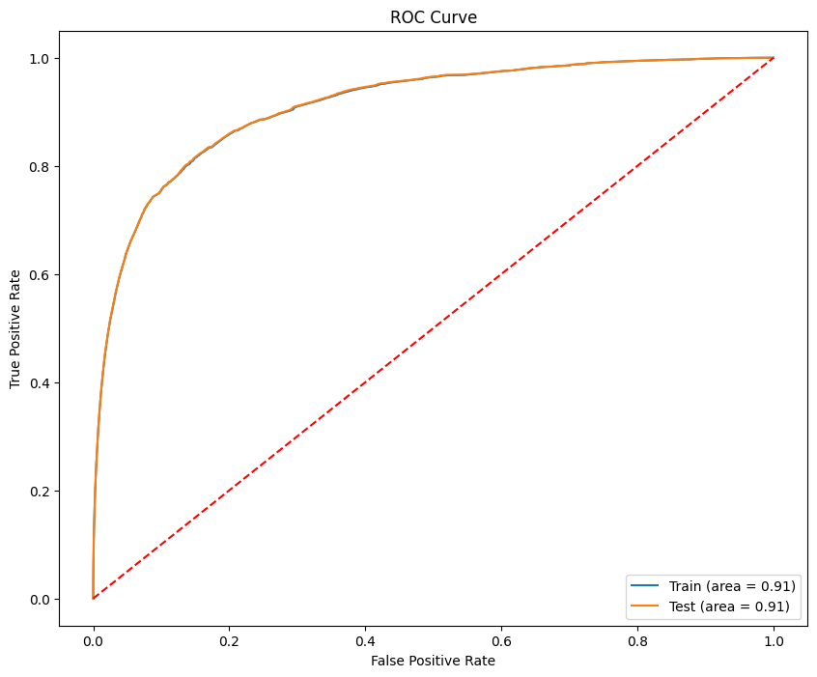
First stage - binary classification
Train ROC AUC: 0.9108343913287731
Test ROC AUC: 0.911446990344491
Confusion Matrix:
[[184582. 2443.]
[ 60407. 40769.]]
For the Majority Class (0):
Recall: 0.9869
Specificity: 0.9869
For the Minority Class (1):
Recall: 0.4029
specificity: 0.9434

Slide 19
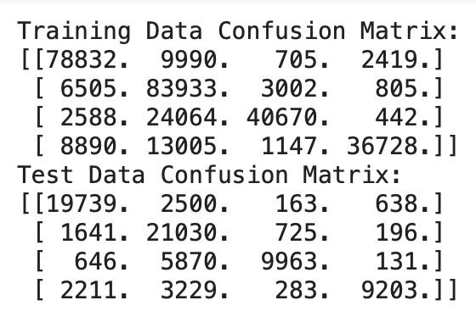
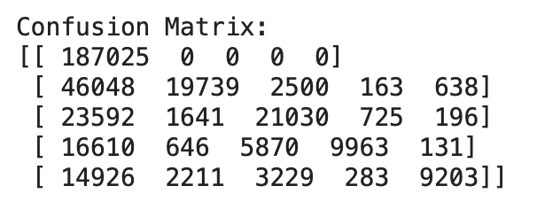
second stage classification
Overall results
Train F1 Score: 0.763486814657958
Test F1 Score: 0.7645873783466283
Total F1 Score: 0.6276493957707988

Slide 20
Conclusion and Reflection
Conclusion:
Development of a two-stage prediction model with 0.63 F1 score accuracy to classify consumer complaints effectively, utilizing NLP techniques and machine learning algorithms
Reduction of data complexity by transforming raw text into structured features, improving the model’s performance
Future Work:
`Exploration of additional ensemble techniques to further enhance model accuracy
Application of more machine learning algorithms for comparison

